Slide 1
Cysteine Prediction in Pea Cultivars Using Raman Spectroscopy and Machine Learning Week – 4
Priyanshu Mittal
July 02, 2026

Slide 2
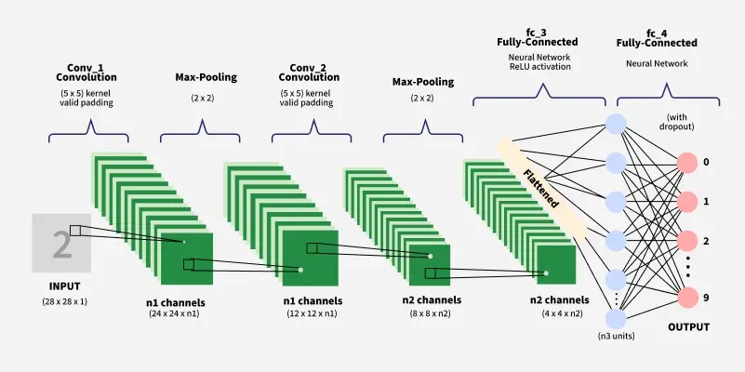
1D Convolutional Neural Network
Convolutional Neural Networks (CNNs) are deep learning models designed to process data with a grid-like topology such as images.
They are the foundation for most modern computer vision applications to detect features within visual data.
CNNs are trained using a supervised learning approach. This means that the CNN is given a set of labeled training images. The CNN learns to map the input images to their correct labels.

Slide 3
How it Works?
Key Idea: A 1D CNN treats the spectrum as a signal and slides small windows along it, learning local patterns like peak shapes, widths and shoulders automatically. No manual feature engineering needed.
Step 1: Convolution: A small filter (kernel size 5) slides along the 1,530 point spectrum. At each position, it multiplies the filter weights with the spectral values and sums them together, detecting local patterns such as peaks.
Step 2: Batch Normalisation: After each convolution, the values are normalised across the batch. This handles intensity scaling differences between spectra internally and reduces dependence on external preprocessing.
Step 3: Max Pooling: Reduces the spectral length by half after each block. It keeps only the strongest detected features and reduces noise.
Step 4: Four blocks, increasing complexity
Step 5: Fully connected layers: Flattened features fed into dense layers → Dropout(0.3) prevents overfitting → single output neuron predicts cysteine value

Slide 4
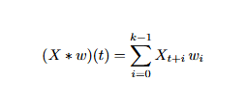
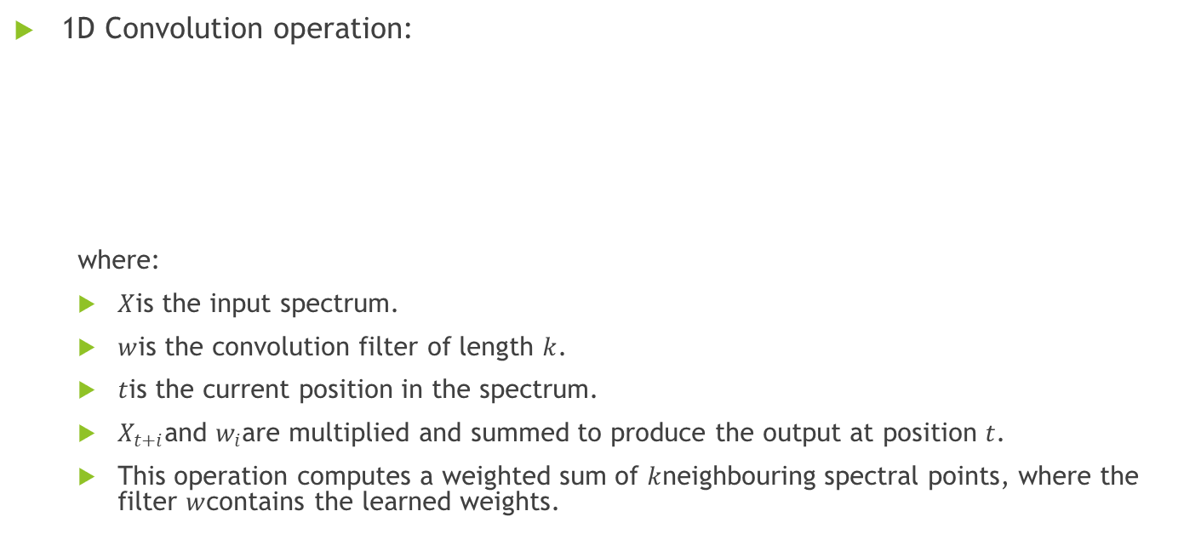
Mathematical Background
1D Convolution operation:
where:
$X$is the input spectrum.
$w$is the convolution filter of length $k$.
$t$is the current position in the spectrum.
$X_{t+i}$and $w_{i}$are multiplied and summed to produce the output at position $t$.
This operation computes a weighted sum of $k$neighbouring spectral points, where the filter $w$contains the learned weights.

Slide 5

Mathematical Background
Batch Normalisation:
where
μ is the batch mean.
σ2 is the batch variance.
ϵ is a small constant for numerical stability.
γ and β are learned scaling and shifting parameters.
This normalises the activations and keeps them in a stable range during training, resulting in faster and more stable convergence.

Slide 6
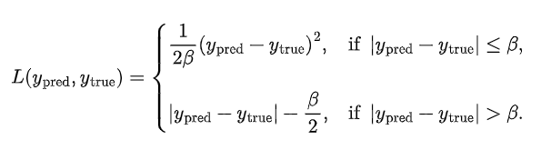
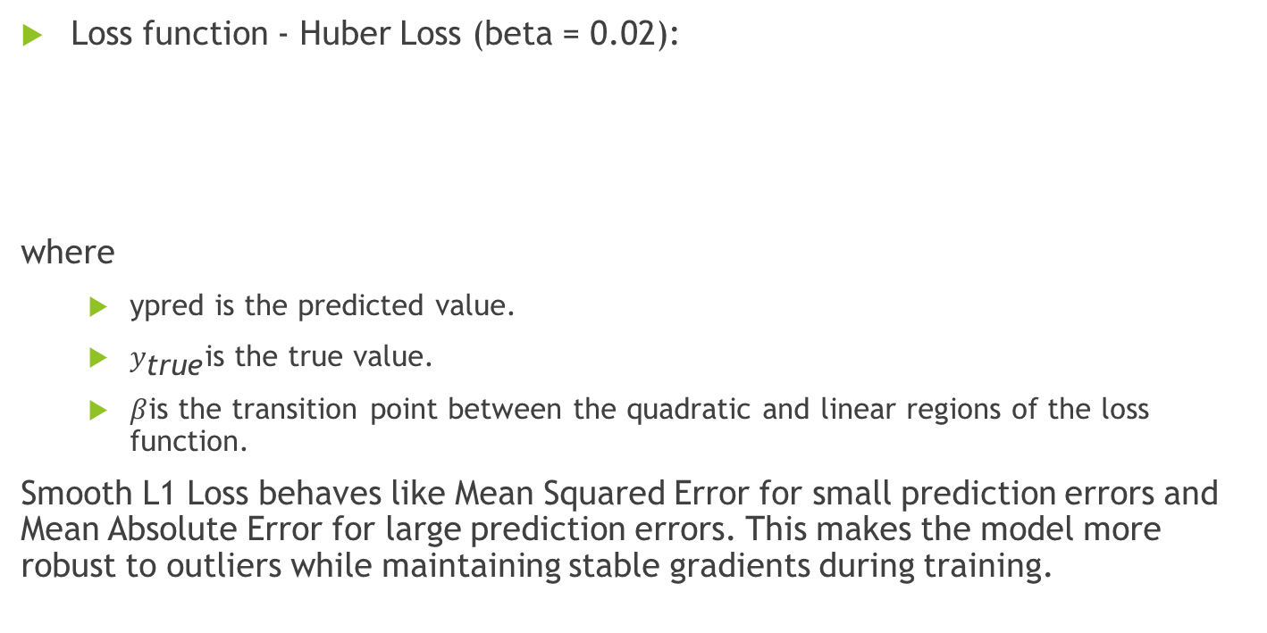
Mathematical Background
Loss function - Huber Loss (beta = 0.02):
where
ypred​ is the predicted value.
$y_{\text{true}}$is the true value.
$β$is the transition point between the quadratic and linear regions of the loss function.
Smooth L1 Loss behaves like Mean Squared Error for small prediction errors and Mean Absolute Error for large prediction errors. This makes the model more robust to outliers while maintaining stable gradients during training.

Slide 7

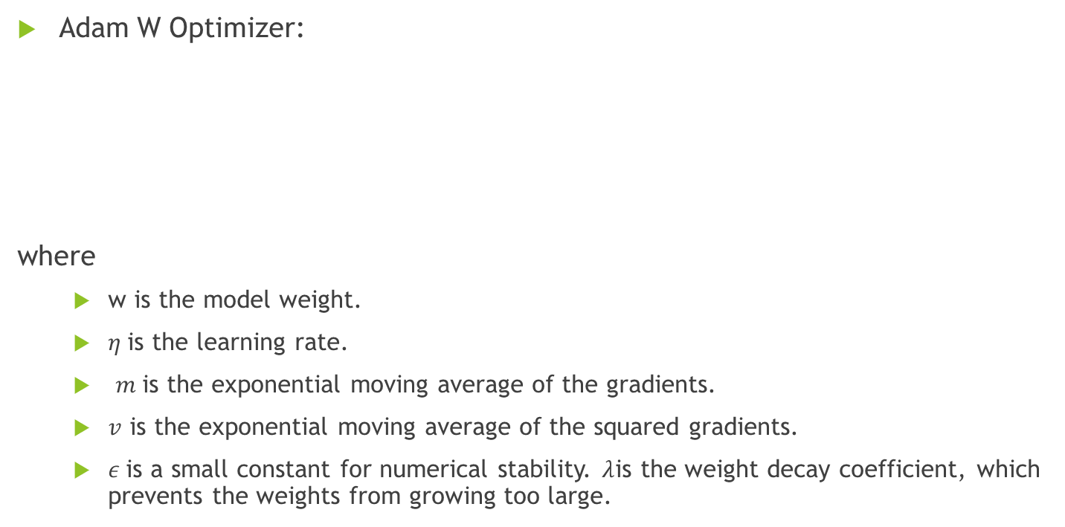
Mathematical Background
Adam W Optimizer:
where
w is the model weight.
$η$is the learning rate.
$m$is the exponential moving average of the gradients.
$v$ is the exponential moving average of the squared gradients.
$ε$is a small constant for numerical stability. $λ$is the weight decay coefficient, which prevents the weights from growing too large.

Slide 8
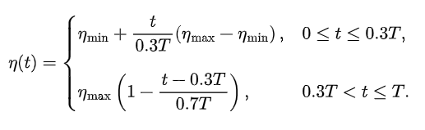
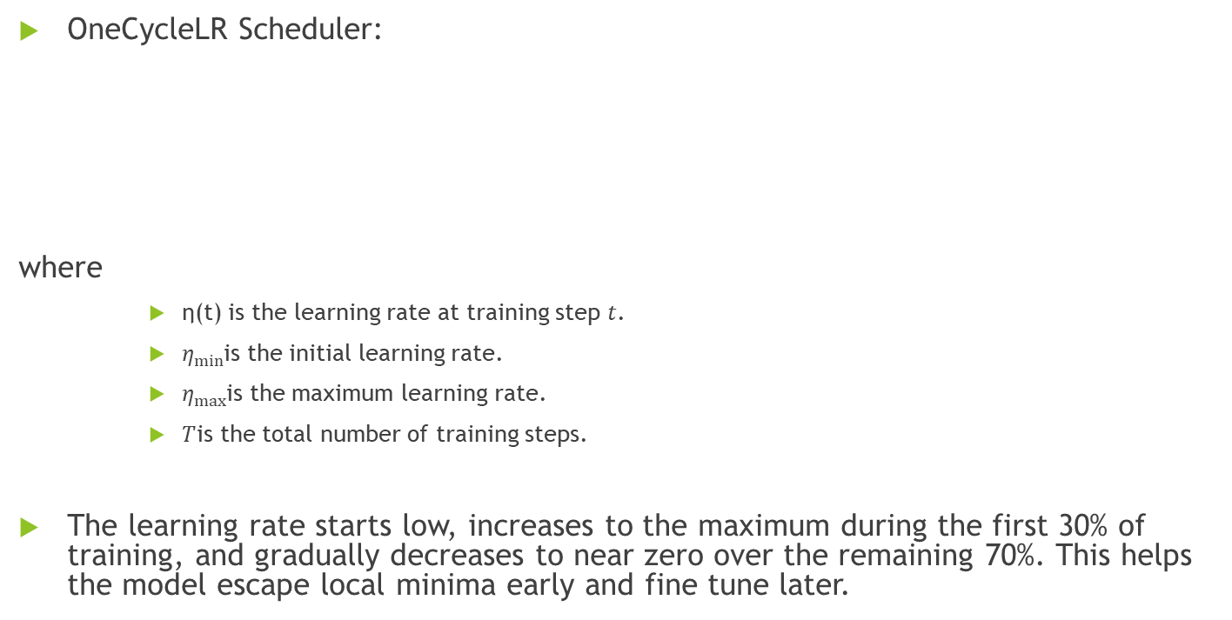
Mathematical Background
OneCycleLR Scheduler:
where
η(t) is the learning rate at training step $t$.
$η_{min}$is the initial learning rate.
$η_{max}$is the maximum learning rate.
$T$is the total number of training steps.
The learning rate starts low, increases to the maximum during the first 30% of training, and gradually decreases to near zero over the remaining 70%. This helps the model escape local minima early and fine tune later.

Slide 9
Step by Step in Coding
Step 1: Preprocessing
Step 2: Convert to PyTorch tensors:
X_pre = snv(savitzky_golay_smooth(X))
# SG smoothing removes high frequency noise
# SNV sets mean=0 std=1 for each spectrum
# BatchNorm inside CNN handles remaining scaling
X_tensor = torch.FloatTensor(X_train) # shape: (5184, 1530)
y_tensor = torch.FloatTensor(y_train) # shape: (5184,)

Slide 10
Step by Step in Coding
Step 3: Create DataLoader
Step 4: Forward Pass: One Batch
dataset = TensorDataset(X_tensor, y_tensor)
loader = DataLoader(dataset, batch_size=32, shuffle=True)
# Feeds 32 spectra at a time to the model
# Shuffles order every epoch so model sees different sequences
y_pred = model(X_batch) # shape: (32,)
loss = criterion(y_pred, y_batch)
# Model predicts cysteine for all 32 spectra
# Huber loss compares predictions to true values

Slide 11
Step by Step in Coding
Step 5: Backward Pass (Learning)
Step 6: Best Model Saving
optimizer.zero_grad() # clear previous gradients
loss.backward() # compute gradients for all 1.6M parameters
clip_grad_norm_(...) # prevent exploding gradients
optimizer.step() # update all weights
scheduler.step() # adjust learning rate
if val_loss < best_val_loss:
best_val_loss = val_loss
best_weights = copy of model weights
# At end of training, restore best weights
# Final model = lowest validation loss, not epoch 100

Slide 12
Step by Step in Coding
Step 7: LOCOCV
for held_out in cultivar_names: # 20 iterations
# Train fresh CNN on 19 cultivars
# Predict held-out cultivar
# Collect predictions across all 20 folds
# Compute global R2 and RMSE at the end

Slide 13
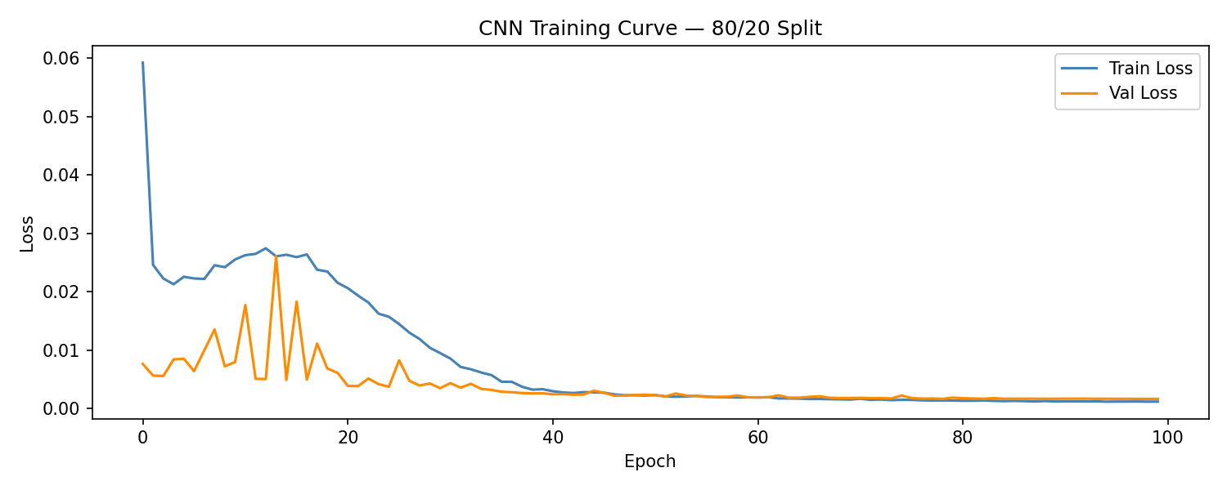
CNN Learning Curve — 80/20 Split
Loss drops steeply from epoch 1 to 40. The model is learning fast.
After epoch 40, the drop slows down. This is the fine tuning phase.
Training and validation loss stay close together. Dropout helps prevent overfitting.
The OneCycleLR scheduler is visible in the curve shape, with a steep drop early followed by a gentle decline later.

Slide 14
CNN LOCOCV – Per Fold Results
Cultivar | True Cysteine | Predicted Mean | RMSE
AAC Chrome | 0.3172 | 0.3218 | 0.0081
AAC Lacombe | 0.3386 | 0.3368 | 0.0053
AAC Liscard | 0.3254 | 0.3233 | 0.0030
CDC Amarillo | 0.3589 | 0.3538 | 0.0127
CDC Athabasca | 0.3412 | 0.3424 | 0.0050
CDC Canary | 0.3145 | 0.3160 | 0.0056
CDC Dakota | 0.3328 | 0.3337 | 0.0045
CDC Golden | 0.3591 | 0.3545 | 0.0060
CDC Greenwater | 0.3464 | 0.3475 | 0.0042
CDC Inca | 0.3653 | 0.3624 | 0.0105
CDC Jasper | 0.3373 | 0.3396 | 0.0049
CDC Lewochko | 0.3413 | 0.3428 | 0.0050
CDC Meadow | 0.3120 | 0.3092 | 0.0047
CDC Patrick | 0.3384 | 0.3399 | 0.0034
CDC Saffron | 0.3468 | 0.3385 | 0.0099
CDC Spectrum | 0.3732 | 0.3376 | 0.0358
CDC Spruce | 0.3457 | 0.3444 | 0.0040
CDC Striker | 0.3450 | 0.3431 | 0.0049
CDC Tetris | 0.3420 | 0.3430 | 0.0037
Redbat 88 | 0.3163 | 0.3216 | 0.0088

Slide 15
CNN LOCOCV – Per Fold Results
8 out of 20 cultivars were predicted with RMSE below 0.011, showing strong generalisation.
CDC Spectrum (RMSE = 0.0358) is the main outlier because it has the highest cysteine value (0.3732), making it an extreme cultivar that the model has never encountered.

Slide 16
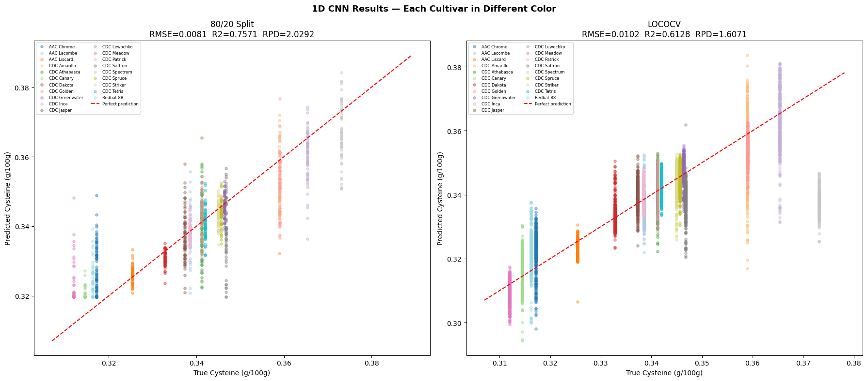
CNN Final Results

Slide 17
1D CNN — Final Results
Metric | 80/20 Split | LOCOCV
RMSE | 0.0081 | 0.0102
R2 | 0.7571 | 0.6128
RPD | 2.0292 | 1.6071
80/20:
Points follow the diagonal well but with some spread. Vertical bands visible because all 324 spectra from one cultivar share one label. R2 = 0.76 shows solid within-cultivar performance.
LOCO: This is the breakthrough. Unlike PLSR, SVR and RF which showed flat horizontal clusters, CNN predictions actually track the true values across the full cysteine range. The diagonal alignment confirms real cysteine signal is being captured.

Slide 18
All 4 Models Compared
Metric | PLSR | SVR | RF | CNN
80/20 RMSE | 0.0122 | 0.0053 | 0.0076 | 0.0081
80/20 R2 | 0.4476 | 0.8935 | 0.7857 | 0.7571
80/20 RPD | 1.3455 | 3.0644 | 2.1604 | 2.0292
LOCO RMSE | 0.0211 | 0.0200 | 0.0188 | 0.0102
LOCO R2 | -0.6481 | -0.4750 | -0.3117 | 0.6128
LOCO RPD | 0.7790 | 0.8234 | 0.8731 | 1.6071
SVR performs best for the 80/20 split (RPD = 3.06), exceeding the screening threshold.
CNN performs best for LOCO by a large margin, with R² improving from -0.31 to 0.61.
All classical models fail in the LOCO evaluation, while CNN succeeds, confirming that deep learning is necessary for cross cultivar generalisation.

Slide 19
Why Does CNN Generalise Better?
PLSR, SVR and RF under LOCO:
These models learn to recognise cultivar-specific absolute intensity patterns.
When tested on an unseen cultivar with different intensity levels (due to substrate batch variation, sample concentration differences), their predictions collapse to the global mean of ~0.34.
CNN under LOCO:
Convolutional filters learn local peak shapes, widths and relative intensities between neighbouring wavelengths.
These features are chemically meaningful and stable across cultivars because they reflect the molecular vibrations of cysteine itself.
BatchNorm inside the network further removes intensity scaling effects that vary between cultivars.

